Slide 1
Forest Conservation Tools at Work in the Upper Mississippi Basin
Legislative Water Subcommittee Meeting
July 15, 2020

Slide 2
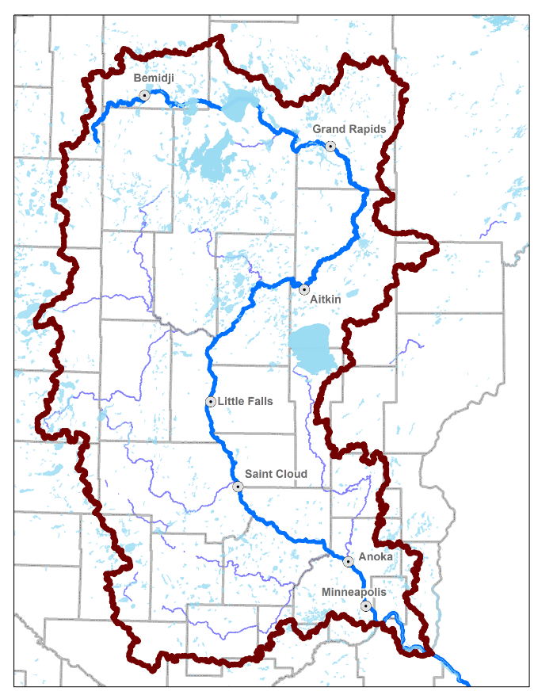
Upper Mississippi River Basin: Context
Upper Mississippi Basin Stats:
Part of 35 Counties
525 Miles of the Mississippi River
7500+ Lakes (over 10 acres)
Largest Source Water in Minnesota

Slide 3
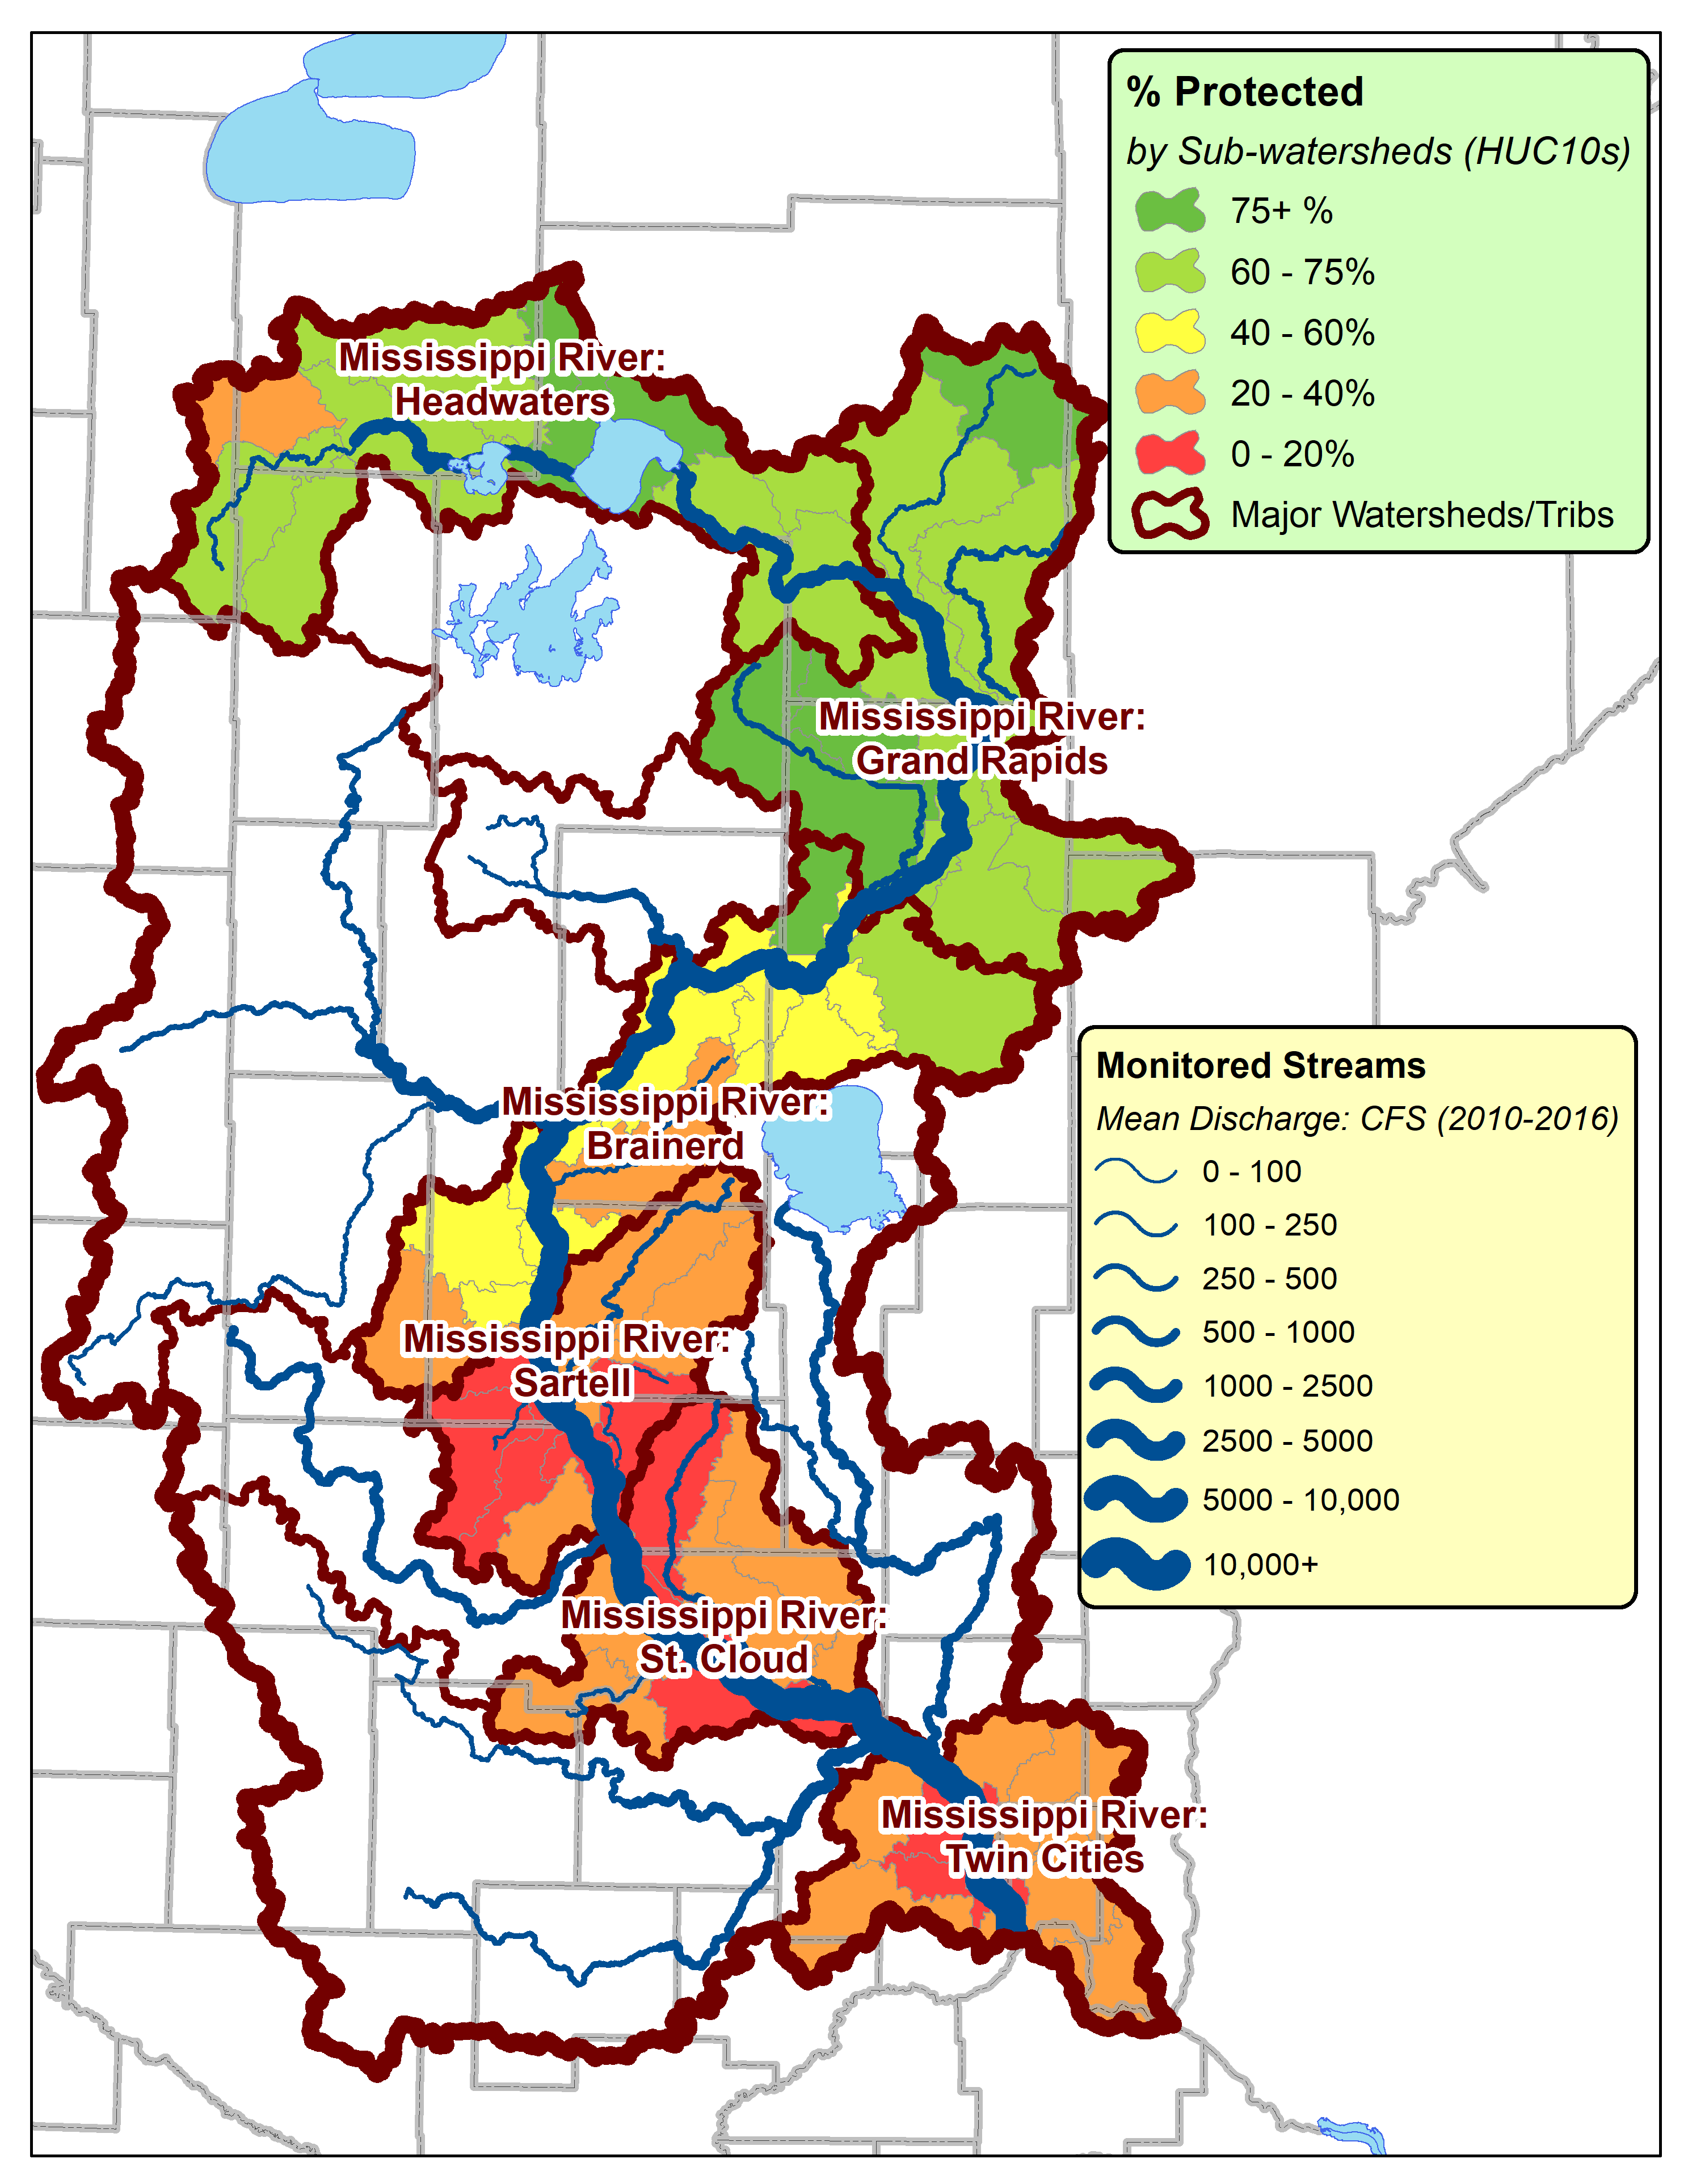
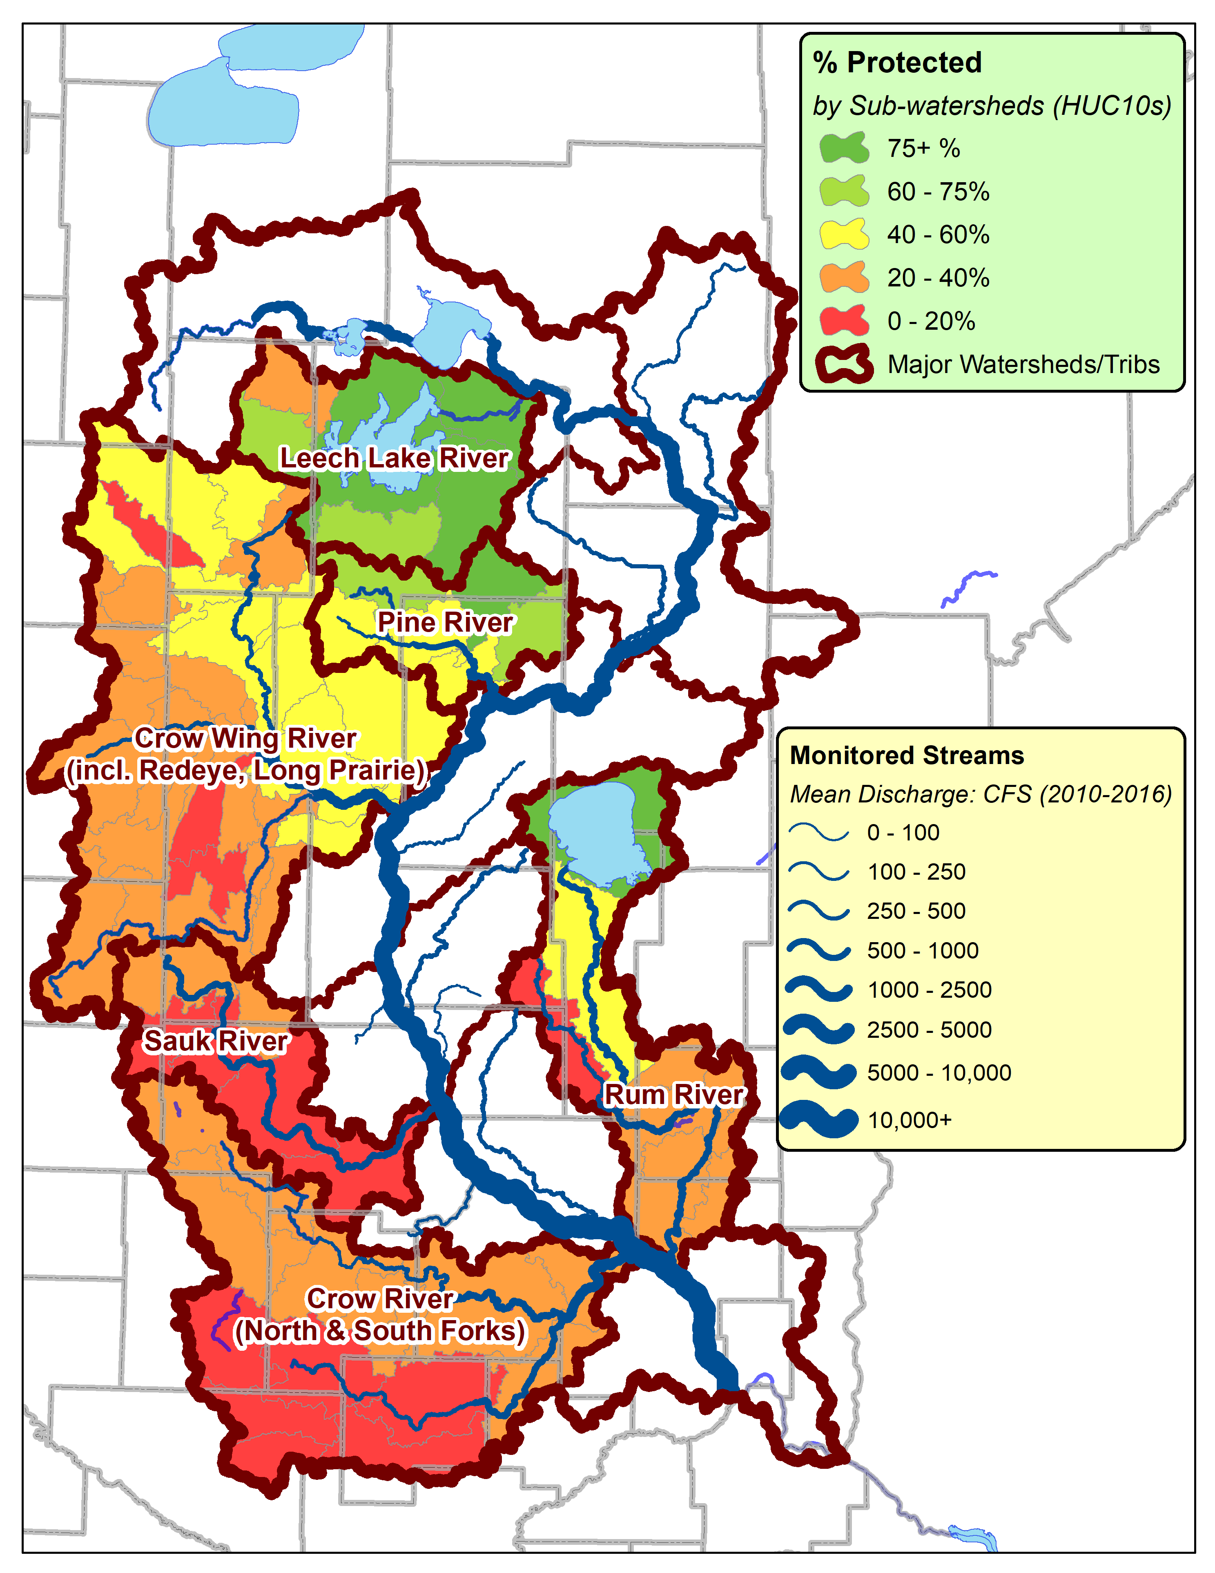
Upper Mississippi River Basin: Context-Major Watersheds
Bi-lateral flow-thrus
Tributaries
Bi-lateral Wshds (6)
Along Main-stem
Flow-through wshds
Population Centers
Tributary Wshds (6)
5 on West, 1 on East
Crow = 2 majors
Crow Wing = 3 majors

Slide 4
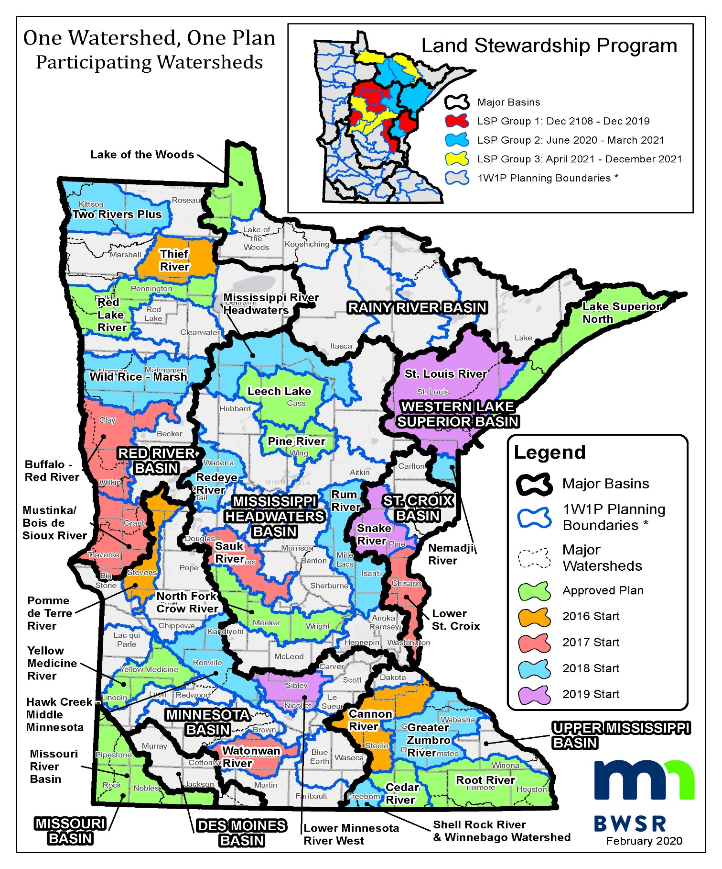
1W1P – Land Stewardship Plan Status

Slide 5
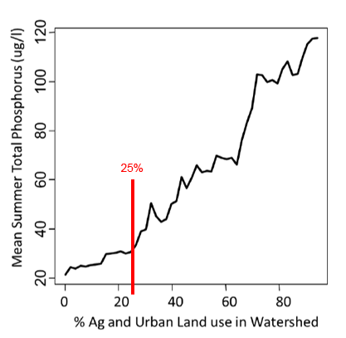
Phosphorus Increases as Forest Cover Decreases

Slide 6
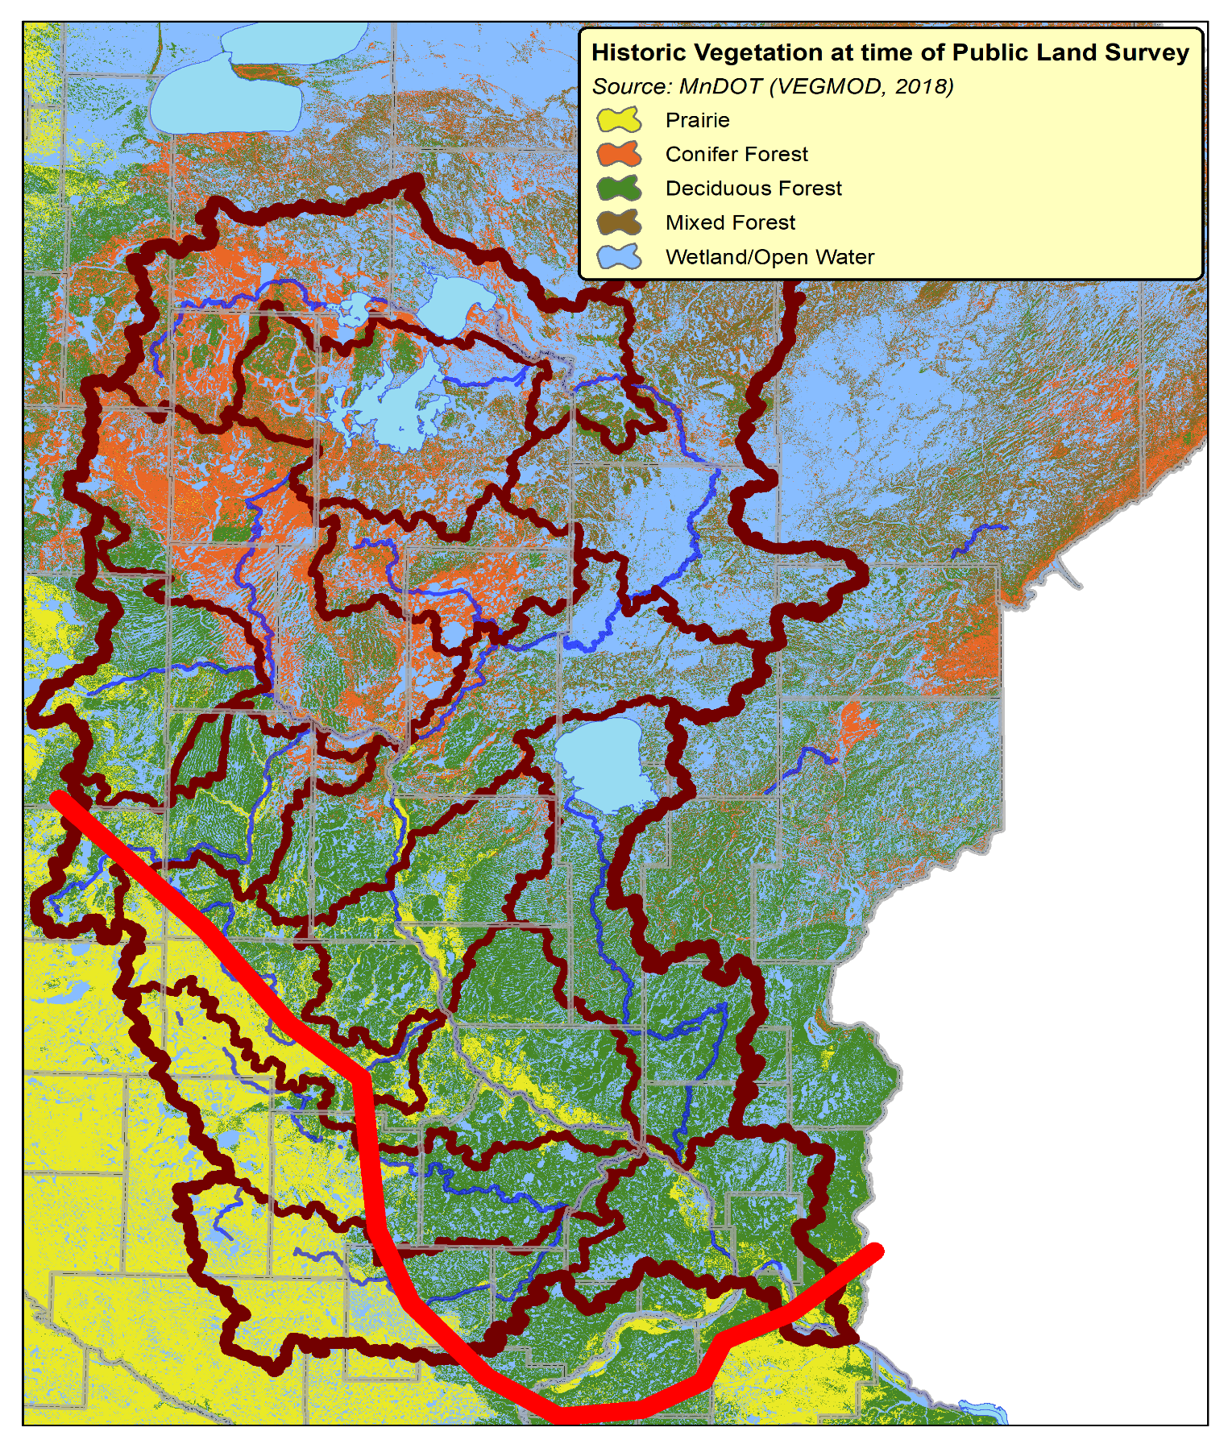
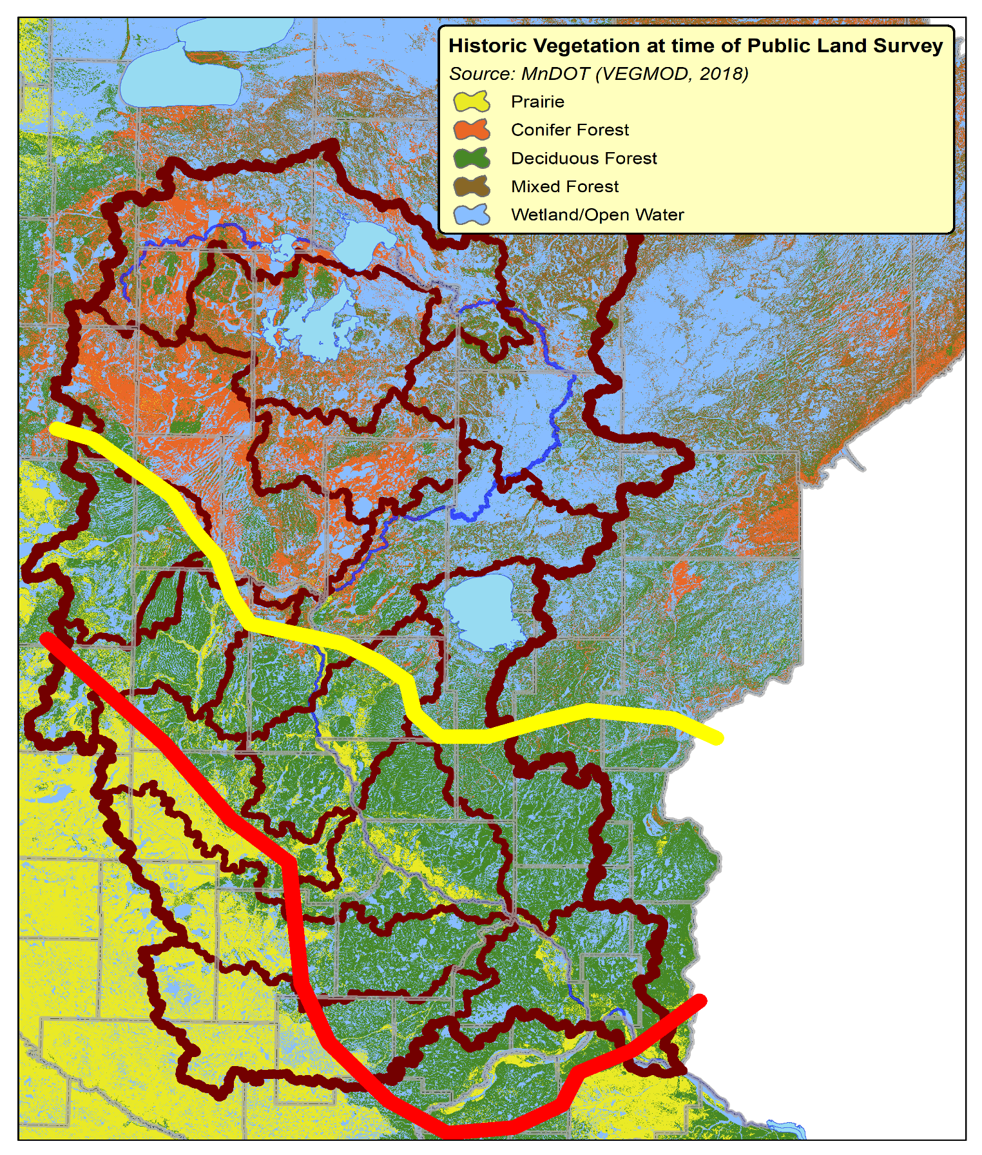
Forested Zone Change
Current Forested Zone
Historical Forested Zone
Forest Loss

Slide 7
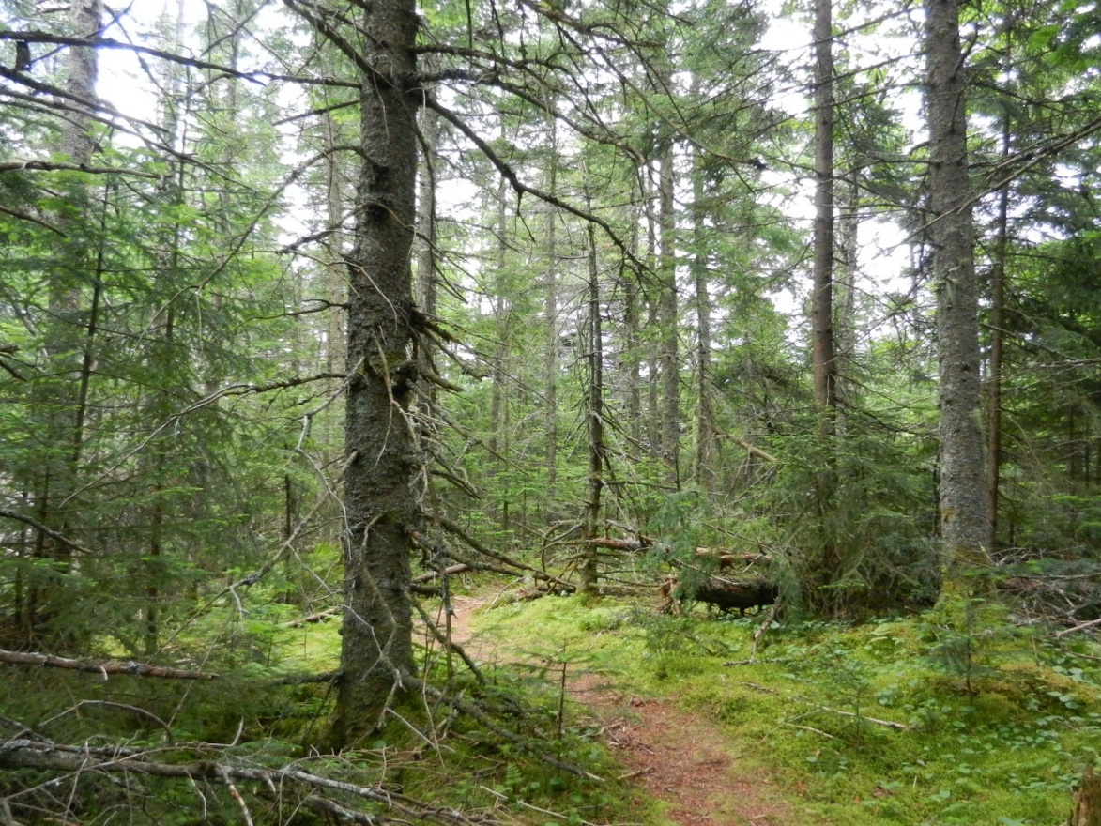
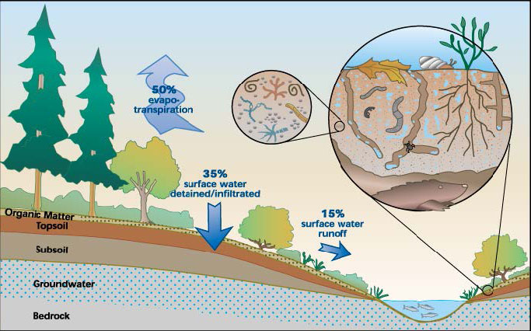
Protect the sponge!
Forests Infiltrate Water

Slide 8
Private Forest Management Tools for Water Quality & Habitat
Fee Title Purchase
Conservation Easements
Forest Stewardship Plans Entry point for most private landowners
SFIA 8-, 20-, or 50- year covenant
Cost-Share Tree planting, site prep, bud-capping, etc.
Timber Harvest
Permanent protection w/ public access
High Cost
Public Ownership
Forest protection, permanent
Private Ownership
Lower Cost
Forest protection, 8-50 years
Land owner revenue/forest renewal
Forest improvement
Information/planning

Slide 9
RAQ Scoring
Finding Priority Parcels

Slide 10
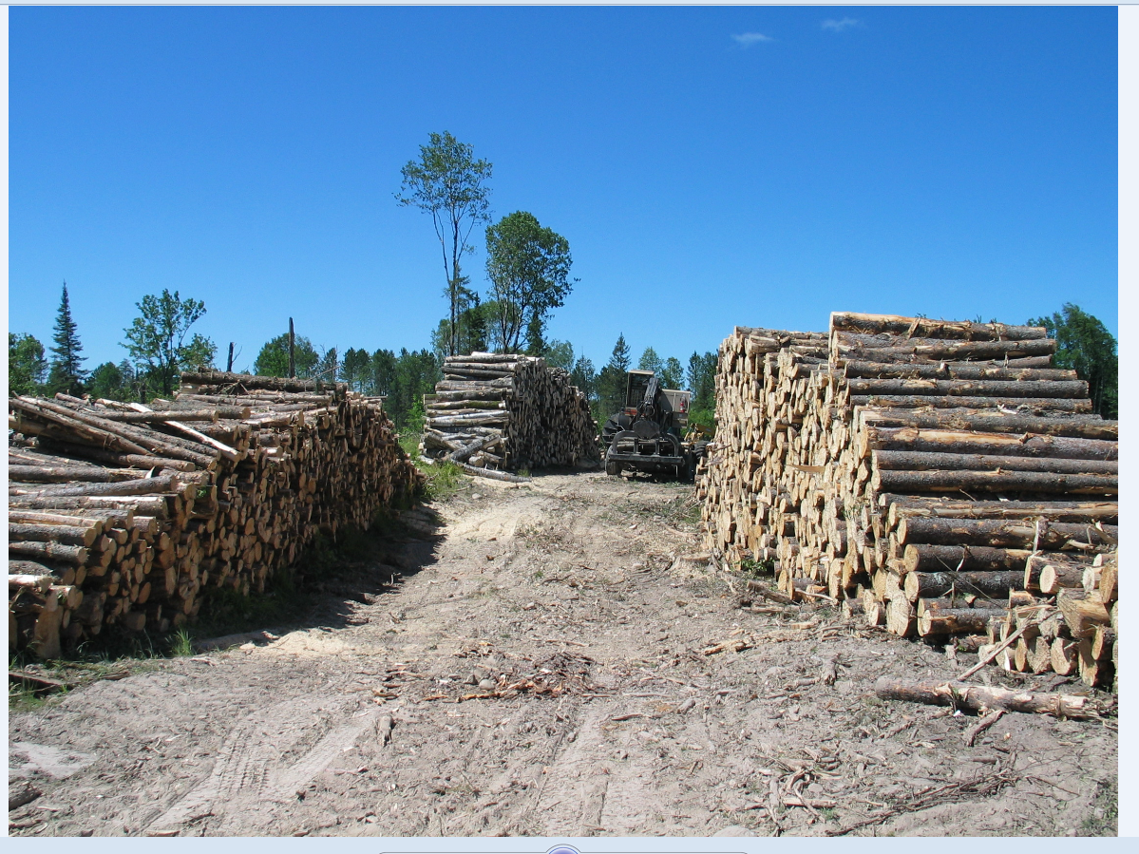
Protection doesn’t mean you can’t manage!
Working Lands

Slide 11
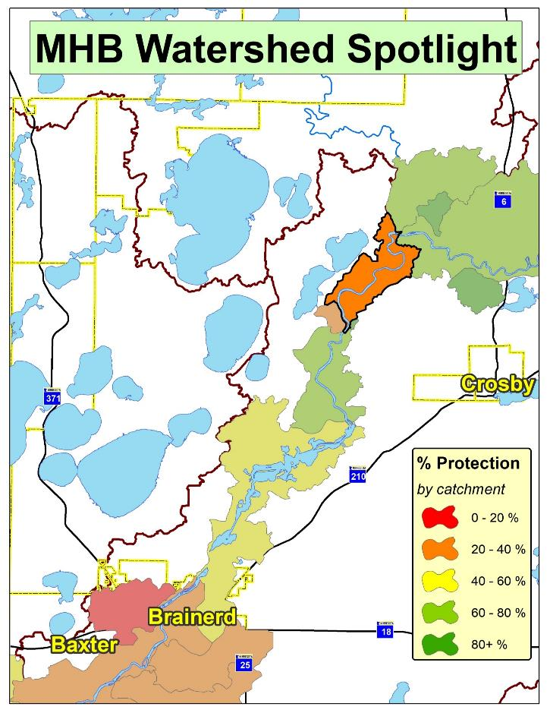
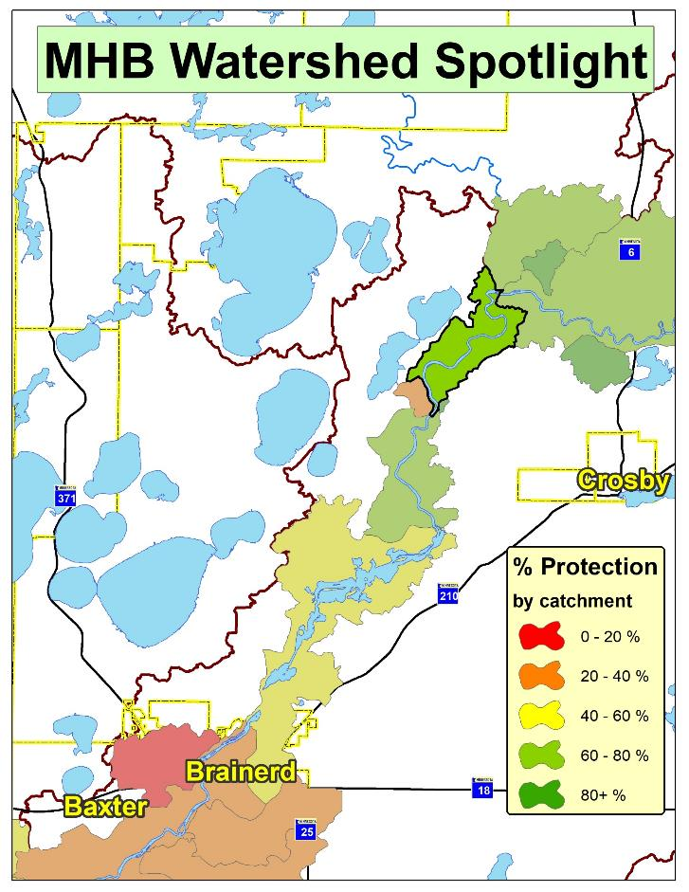
Implementation Success Story: Mississippi River

Slide 12
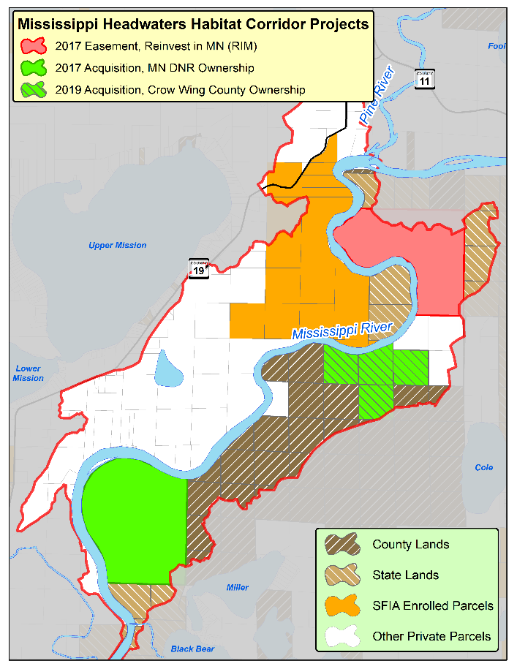
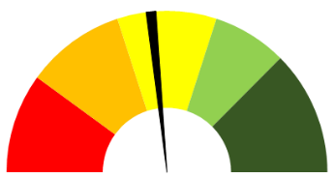
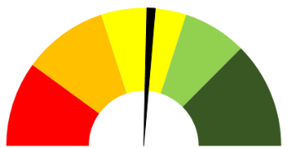
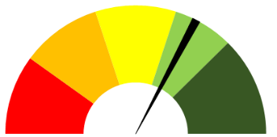
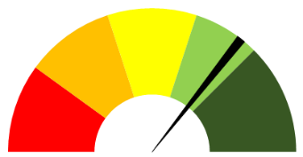
Implementation Success Story
37%
46%
w/ Public Lands
w/ 2017 Acquisition
51%
66%
w/ 2017 Easement
w/ SFIA
Current: 71%
w/ 2019 Acquisition

Slide 13
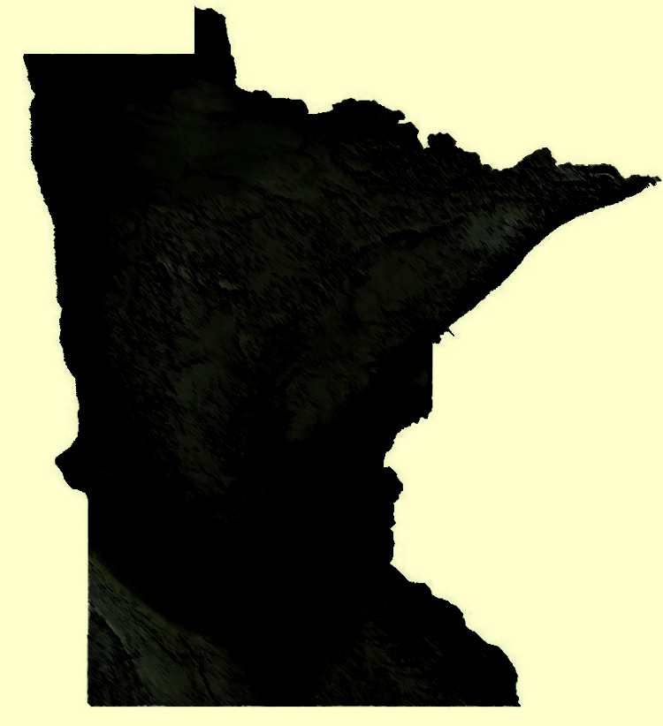
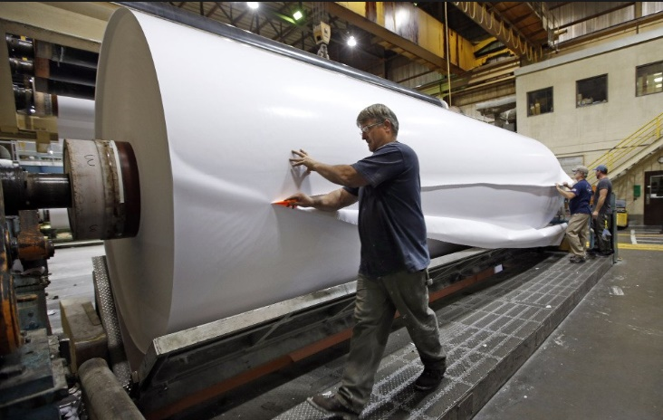
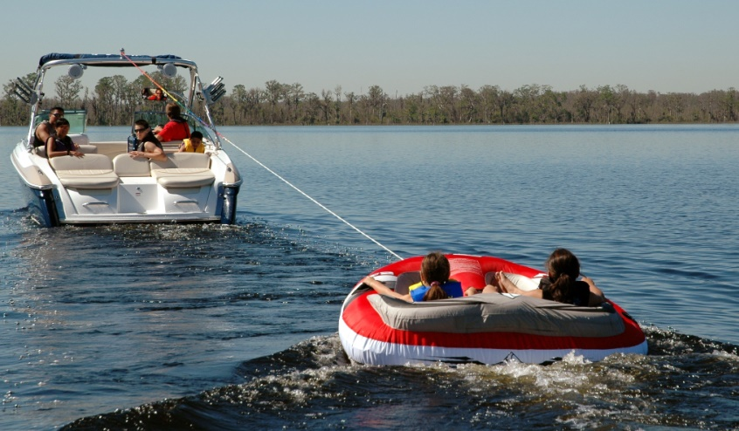
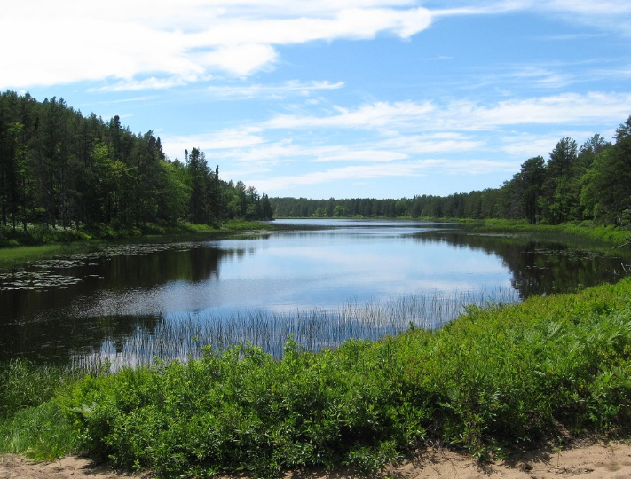
Quality Forests + Quality Water = Quality Life

